Slide 1
Year 6 School Journey
Tuesday 29th October to Friday 1st November 2024
Notes:
Why do we go to PGL, Isle of Wight?
The site that we visit on the Isle of Wight is PGL, Little Canada- in Wootton- not far from the Ryde ferry terminal. It is a secure site with great facilities, accommodating staff and fun activities. It is a beautiful location on creek and a short walk to the beach- with views across the Solent, back to Portsmouth. Whilst on site, the children rotate around the activities, in groups, with an adult from school supervising and each activity is run by trained members of the PGL team.

Slide 2
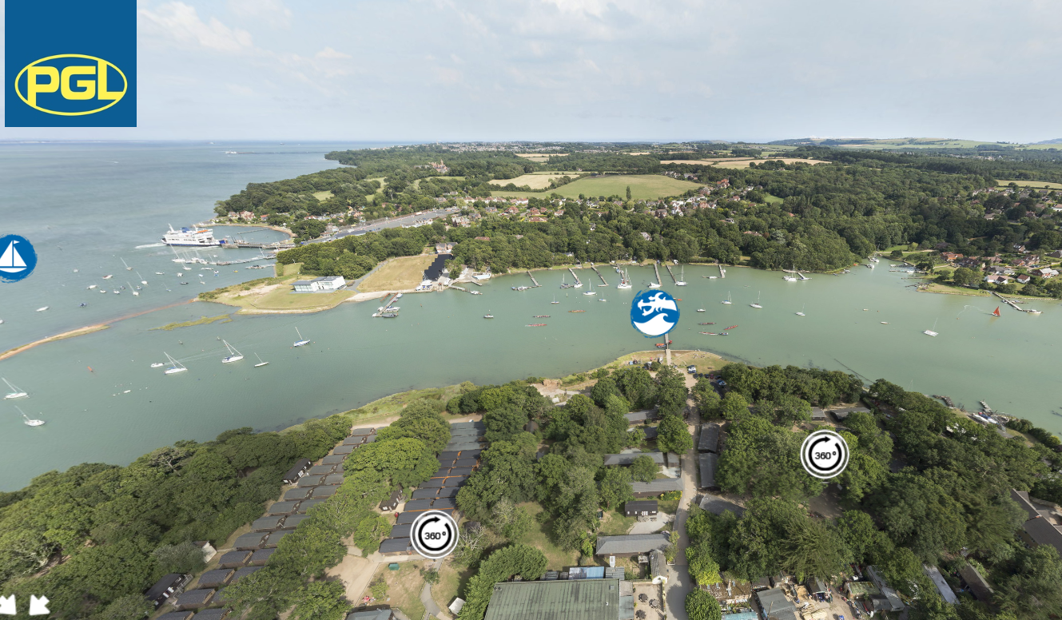
Why the Isle of Wight?
Notes:
We choose to go to the Isle of Wight as it does feel like a holiday, especially as we have the ferry crossing to look forward to. We plan the trip for the start of Year 6 as it gives the children chance to build of friendships that they have; to make new friends in the year group; to become more independent as they are away from home and most of all, to make life long memories.

Slide 3
Travel….
Notes:
How do we get there?
On the morning of the trip, the children arrive at school with their case or holdall. After registration, we take the coach down to Portsmouth and then the Wight Link ferry across the Solent to Ryde, Isle of Wight (which takes about 45 minutes). From here it’s about a 15-minute journey to the PGL site.
We aim to return on the Friday at about 4pm.

Slide 4
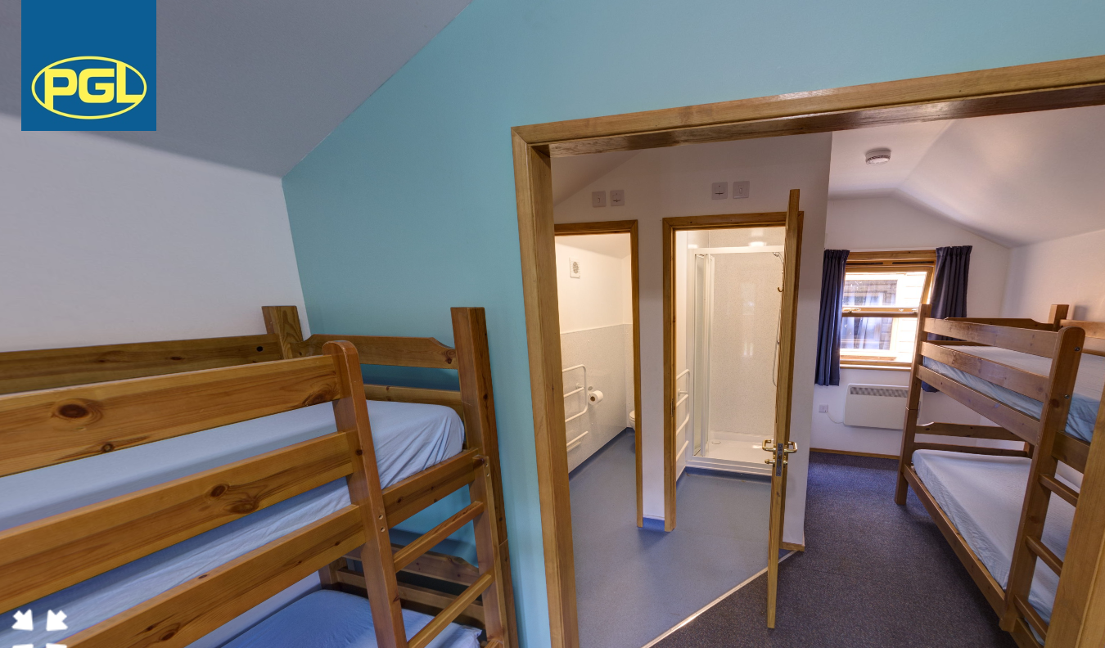
Accommodation
Notes:
Where do we sleep?
Children are accommodated in cabins, of between 4 and 8 children. Staff rooms are interspersed between the children’s, so that they know where to go should they need someone- especially in the night. Fitted sheets are provided on the bunk beds, but children will need to take a sleeping bag with them. Each cabin is heated and has an ensuite with toilet and shower facilities. If you are worried that your child may sleepwalk, alarms can be fitted to the door to the cabin during the night.
Who do we share with?
Before our visit, the children will complete a post-it with the names of three children that they would be happy to share with. We guarantee that they will be with at least one of their choices. They will find out who is in their cabin upon arrival at PGL.

Slide 5
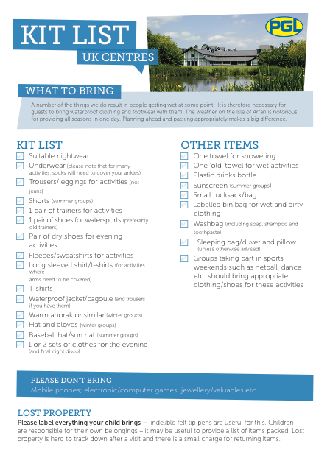
Kit List
Notes:
What do we need to take with us?
Other than a sleeping bag and torch, specialist equipment is not needed for this trip. Lots of layers of warm, old clothes are the priority, along with water proofs, coats, hats, old trainers and wellies.

Slide 6
Kit List
DO NOT BRING……
Mobile phones, hand-held devices, digital cameras or anything electronic.
DO BRING….
Disposable camera, book to read, crossword, sudoku, teddy bear and post card/ letter with address and stamp.
Notes:
Can we take electronics?
The trip is a digital detox: no phones or other devices are to be taken. A reading book, teddy, playing cards, UNO and a blank postcard are best- there is a post box on site!

Slide 7
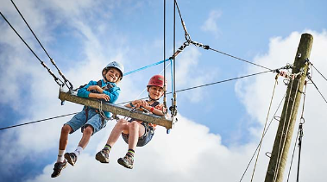
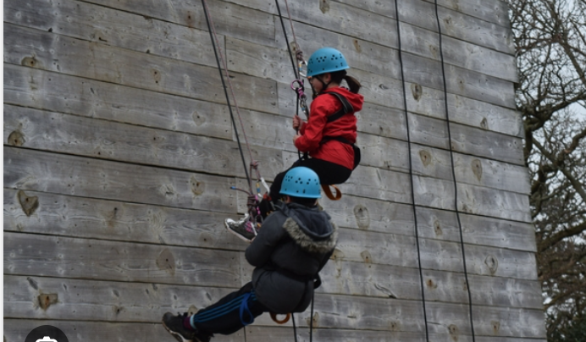
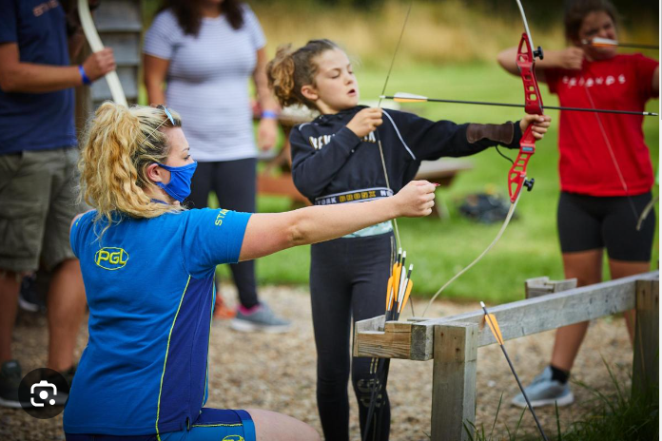
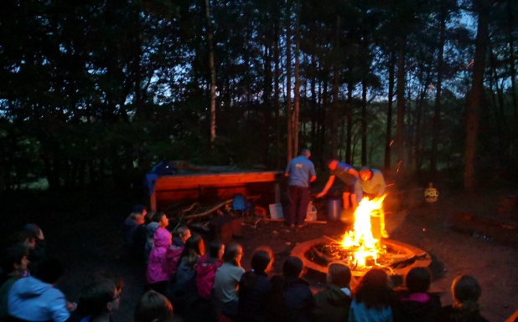
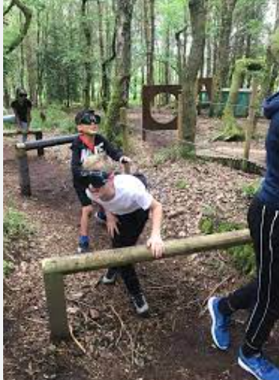
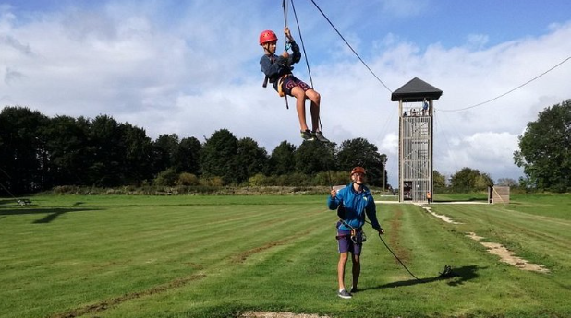
A typical day..
Wake up and get dressed.
Breakfast
Activity One
Short Break
Activity Two
Lunch
Activity Three
Short Break
Activity Four
Dinner
Evening Activity.
Shower and Bed
Notes:
What do we do in the day?
A full day at PGL is full on: the children get up and dressed early for breakfast. (see slide for outline of day). We will not know which activities we’ll be allocated until just before the trip, but some of our favourites include: the 3G swing, zip wire, archery, problem solving, sensory trail, the matrix, abseiling, climbing, camp fire, sports night, camp fire etc…. Activities finish at about 9.15pm, where the children will have some time to have a shower and chill out in their rooms before bed.
On the first day, we start at activity three (after lunch) and on the final day we take part in all sessions until lunch.

Slide 8
Food
Notes:
What do we eat?
The food at PGL is amazing and there is something for everyone. Breakfast is a range of cereals, toast, yoghurts and fruit, as well as a selection of cooked items like sausage and beans, or scrambled eggs and bacon. Big cooked lunches and dinners are provided, with a selection of mains on offer- the children can add bread and butter, or salad to the meals too.

Slide 9
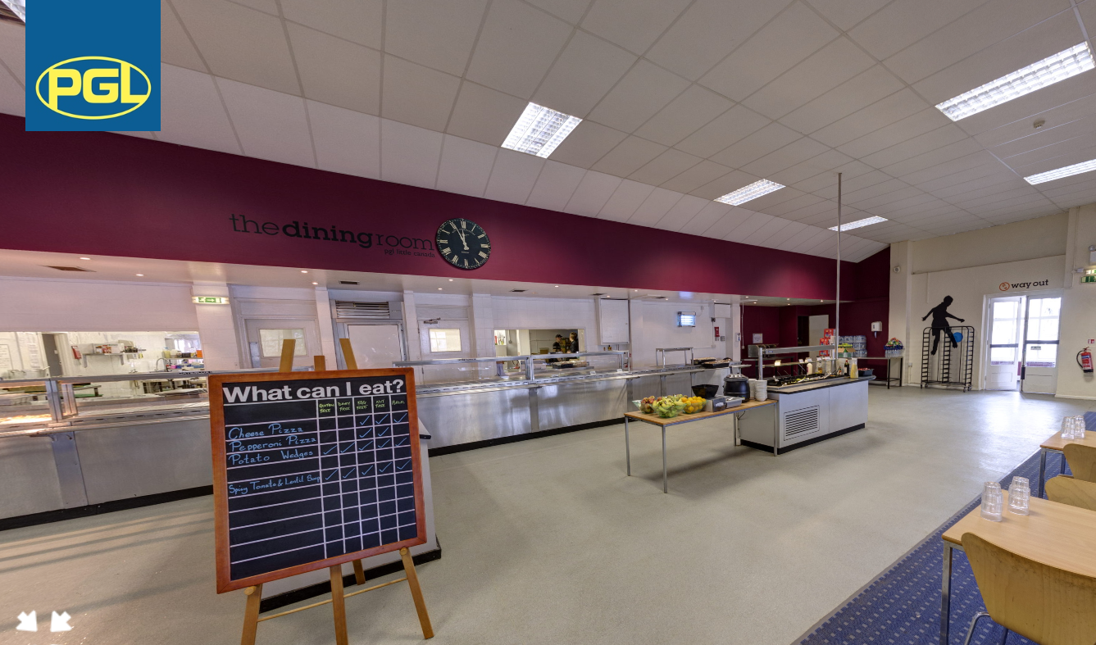
Food
Notes:
For children with allergies and intolerances, a ‘What can I eat?’ board can be found at the front of the dining hall, which shows which foods they can eat. The kitchen staff are amazing and will cater to most requests.

Slide 10
Cost….
£290 for the four day trip.
£40 initial non-refundable deposit paid to office no later than Friday 21st July 2023.
Then, unless you want to pay the full balance, everybody will be placed on the payment scheme.
£35 by no later than 31st October 2023
£20 by no later than 31st December 2023
£35 by no later than 31stJanuary 2024
£35 by no later than 28th February 2024
£35 by no later than 31st March 2024
£35 by no later than 30th April 2024
£35 by no later than 31st May 2024
£20 by no later than 30th June 2024
and MUST be made by listed dates, otherwise place will be lost.
Notes:
How do I sign up?
You should have already received both paper and online copy of the payment plan. To reserve a place for your child on the trip, a non-refundable deposit of £40 is required by Friday 21st July 2023. Payments should be made in instalments, or larger chunks can be paid off until £290 is paid in full. (see payment plan).

Slide 11
Questions…..
https://www.pgl.co.uk/en-gb/adventure-holidays/centres/little-canada
https://www.shearsgreenjuniorschool.co.uk/pgl-nov-2022/
Notes:
How can we find out more?
Should you wish to see for yourself what PGL, Little Canada is like, a link can be found on the last slide for their website. Additionally, you can click on the PGL page on our school website, to have a browse of the photos of our current Year 6 children’s trip. We always aim to take as many photos as we can whilst we’re away, so that you can have a glimpse into your child’s trip.
Why should we sign up?
Your child’s time at Shears Green is about making memories- and every year, our Year 6s say that this trip is one of the highlights of their time at primary school. We’d love for as many of your children to join us on this exciting adventure- you can sign up through the Arbor app, or via a cash payment to the school office.
If you have any queries, please contact me, Emma Abbott at: 6ea@shearsgreen-jun.kent.sch.uk

